Slide 1
EduAssess360 – Exam and Preparation App
Nahidul Islam Shakin
Student ID: 18CSE246
Department of Computer Science and Engineering,
Bangabandhu Sheikh Mujibur Rahman Science and Technology University, Gopalganj-8100, Bangladesh
Supervised by
Dr. Mrinal Kanti Baowaly
Associate Professor,
Department of Computer Science and Engineering,
Bangabandhu Sheikh Mujibur Rahman Science and Technology University, Gopalganj-8100, Bangladesh

Slide 2
What is EduAssess360?
Definition: EduAssess360 is an AI-powered mobile application designed to enhance exam preparation by providing tailored resources, performance analysis, and feedback.
Purpose:
Simplify the preparation process.
Address inefficiencies in traditional methods.
Offer personalized study guidance.
Key Impact:
Saves time.
Improves exam readiness.
Provides actionable insights for better performance.

Slide 3
Introduction
Problem Statement:
Traditional exam preparation is inefficient.
Lack of personalized feedback.
Difficulty in accessing focused study materials.
Solution:
EduAssess360: An AI-powered app offering tailored resources, performance analysis, and feedback to optimize exam readiness.

Slide 4
Key Features
MCQ Exam
AI based note generate after MCQ exam
Category-wise Exams
Exams for SSC, HSC, and university, Job levels.
AI-Generated Notes
Suggestions based on user performance.
Pre-exam Resources
Syllabus, guides, and notes.
Reward System
Gamified learning experience.
Admin Panels
Question management and feedback.

Slide 5
Project Significanc
Enhances exam preparation efficiency.
Saves time with organized resources.
Provides actionable feedback and insights.
Benefits students, educators, and administrators.

Slide 6
Goals and Objectives
Goals:
Personalized exam preparation.
Structured learning experience.
Objectives:
Cross-platform mobile app.
AI-driven result analysis.
Admin and teacher management panels.

Slide 7
Implementation Details
Technology Stack:
Framework: Flutter (Dart).
Database: Firebase (Remote) & sqflite (local storage).
Tools: Android Studio, GitHub.
Architecture: MVVM for clean, maintainable code.
Methodology: Agile development for iterative progress.

Slide 8
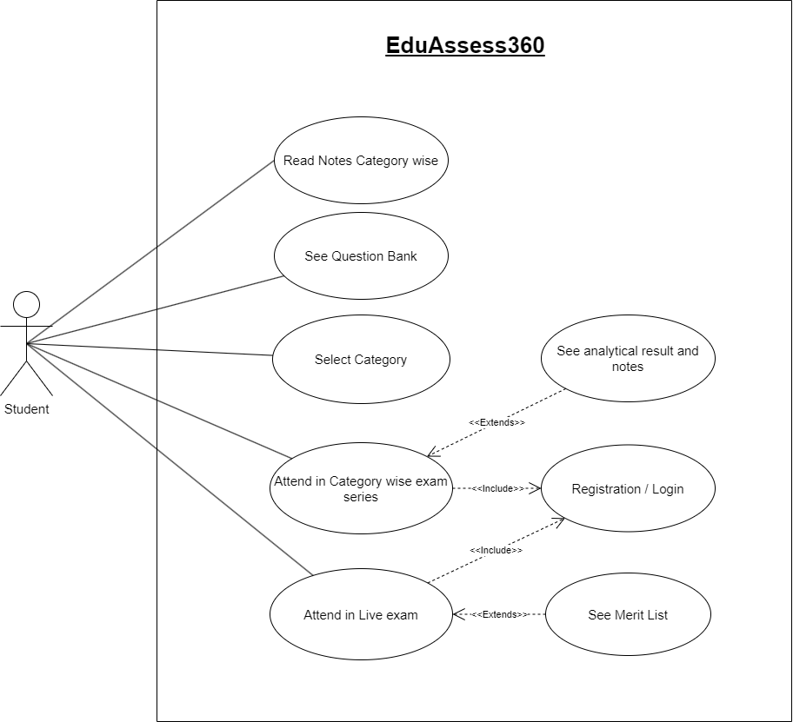
Student Use Cases

Slide 9
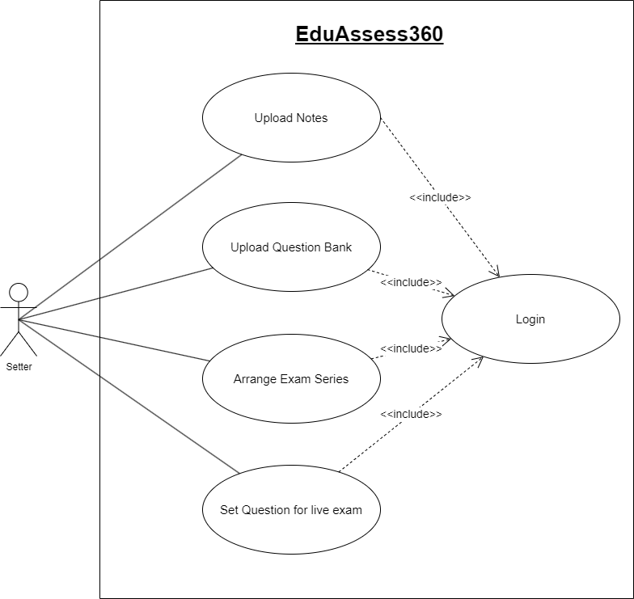
Admin use cases

Slide 10
Future Enhancements
Multilingual support for wider accessibility.
VR integration for interactive learning.
Advanced AI for better trend analysis.
Offline mode for seamless learning.

Slide 11
Challenges and Risks
Challenges:
Synchronization between local and remote databases.
AI accuracy for feedback.
Risks:
Dependency on third-party tools.
Adhering to app store policies.
Ensuring data privacy.

Slide 12
Testing and Feedback
User Feedback:
Intuitive interface appreciated.
Suggestions for more categories and faster response times.
Testing Metrics:
Performance, usability, and security thoroughly validated.

Slide 13
Benefits
Saves preparation time with organized resources.
Improves performance with actionable feedback.
Engages users through gamification.
Provides a streamlined experience for educators and admins.

Slide 14
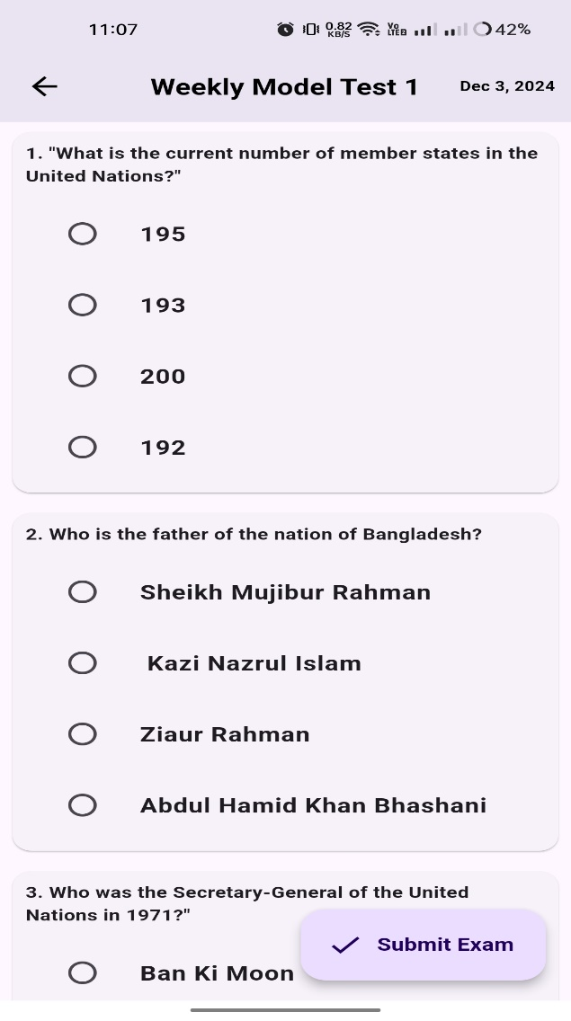
Screenshots of student exam page

Slide 15
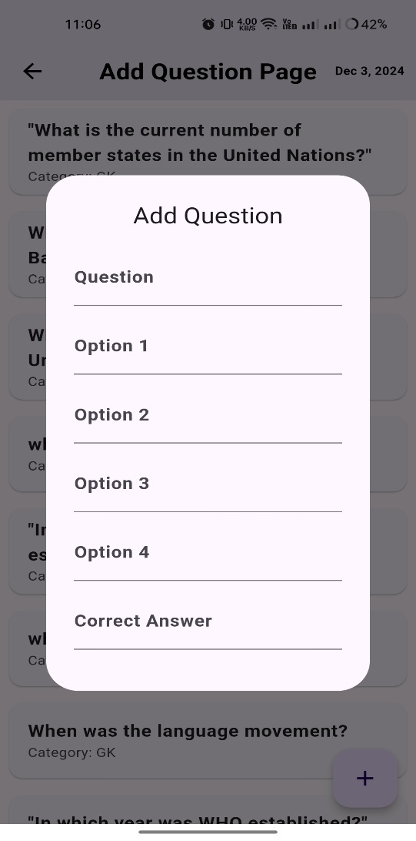
Screenshots of admin adding question

Slide 16
Conclusion
Personalized Feedback: Tailored performance insights to help users identify strengths and areas for improvement.
Organized Learning Resources: Access to comprehensive study materials, guides, and notes, simplifying the preparation process.
Gamified Engagement: Reward system and level progression to keep users motivated.
Future-Ready Innovations:
Potential for multilingual support to cater to diverse user bases.
Integration of VR for interactive and immersive study sessions.
Ongoing AI enhancements for deeper performance analysis and adaptive learning.

Slide 17
Question and Answer

Slide 18
Thank you

